Slide 1
Geethanjali College Of Engineering And Technology
Voice of Village: Fund Transparency & Issue Reporting System
Internal Guide – CH. Sandhya
Batch No : E11
22R11A05M9 – P. Uday Yadav
22R11A05N9 – V. Satwik Reddy
22R11A05M2 – M. Manikanth Reddy

Slide 2
PROBLEM STATEMENT
The Voice of Village: Fund Transparency & Issue Reporting System is designed to address the lack of transparency and accountability in rural governance. In many villages, residents are often unaware of how government funds and public donations are allocated and spent on development activities. Additionally, there is no organized digital platform for villagers to report local issues such as infrastructure problems, water supply, electricity, or sanitation. This lack of transparency and communication leads to mistrust, inefficient fund management, and unresolved community problems. Therefore, a centralized web-based system is needed to provide transparent financial information, enable villagers to report issues, and allow authorities to track and resolve complaints effectively.

Slide 3
PROPOSED SYSTEM OVERVIEW
The Voice of Village: Fund Transparency & Issue Reporting System is a web-based platform developed to improve transparency and accountability in rural governance. It allows villagers to view information about government fund allocations, track expenses, and understand how funds are utilized for village development. By providing clear financial data through a centralized system, the platform helps increase trust and awareness among villagers.
In addition to financial transparency, the system also includes an issue reporting feature where villagers can report problems related to infrastructure and public services. These issues can be tracked with statuses such as pending, in progress, and resolved. Administrators like the sarpanch or village authorities can manage funds, update expenses, and resolve complaints through an admin panel, ensuring efficient management and better communication between citizens and local authorities.

Slide 4
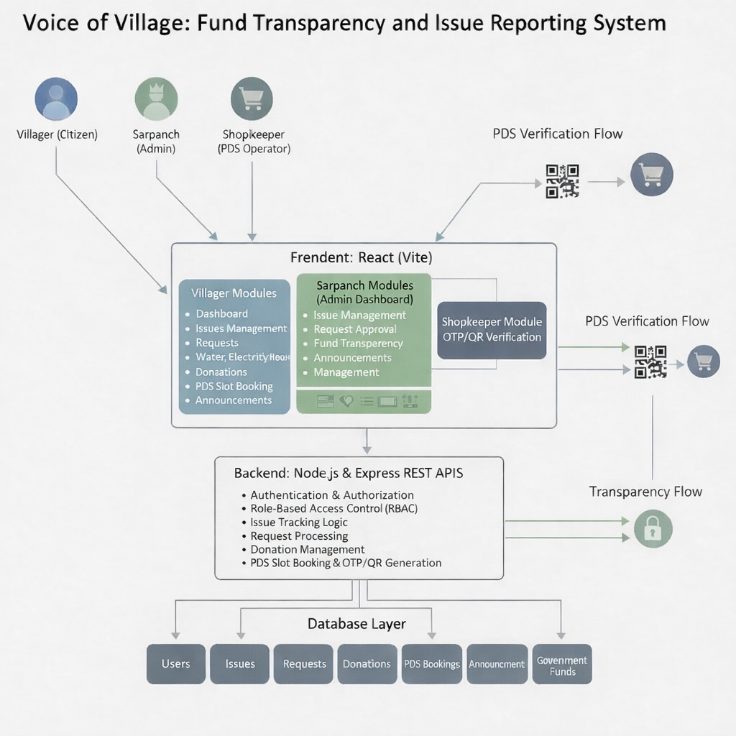
SYSTEM ARCHITECTURE

Slide 5
1. Frontend Layer
Built using React.js
Provides user interface for villagers and administrators
Handles user input and sends requests to the backend via REST API
2. Backend Layer
Built using Node.js and Express.js
Handles business logic, authentication, and API requests
Processes requests from the frontend and interacts with the MySQL database
3. Database Layer
Uses MySQL for structured data storage
Stores data related to users, funds, donations, and issues
Supports secure data retrieval and updates for the backend system
4. External Services
Claude AI for scoring engine

Slide 6
TECHNOLOGY STACK
Frontend:
• React.js, HTML5, CSS3, JavaScript Selected for fast development, reusable components, and responsive UI design.
Backend:
• Node.js, Express.js Chosen for high performance, built-in validation, and easy REST API development.
Database:
• MySQL SQLite for simplicity during development; PostgreSQL for scalability and reliability in production.
Tools Used:
• Git & GitHub • Postman • VS Code Used for version control, API testing, and efficient code development.

Slide 7
PROJECT MODULES
1. Identity & Access Management Module – Completed Manages user authentication, secure login, and role-based access control for villagers and administrators.
2. Fund & Budget Management Module – Completed Handles government fund allocation, expense tracking, and monitoring of remaining village development funds.
3. Issue / Complaint Management Module – Completed Allows villagers to report issues related to infrastructure and public services, while enabling administrators to update and resolve complaints.
4. Donation Management Module – Completed Supports public donations for village development and records all transactions to ensure transparency and accountability.
5. Transparency Dashboard & Audit Module – Completed Provides visual dashboards showing fund usage, donation records, and complaint statistics, along with audit logs for system monitoring.

Slide 8
IMPLEMENTATION PROGRESS
Overall Project Completion: 65%
✔ Features Completed
Frontend interface for fund transparency dashboard
Issue / complaint reporting interface
Donation module interface
Basic user authentication interface
Initial backend setup and API structure
✔ Database Integration Status
Core database tables designed (Users, Funds, Donations, Issues)
Database schema and relationships defined
Backend–database connection configured
CRUD operations currently in development
✔ Authentication Implemented
JWT-based authentication system implemented
Role-Based Access Control (RBAC) for villagers and administrators
Protected API routes to ensure secure system access
✔ APIs Connected
Frontend integrated with backend REST APIs
Secure communication between frontend and backend using Axios
Core modules such as fund management, issue reporting, and donations tested successfully

Slide 9
DATABASE DESIGN
Number of Tables: The system consists of 4 main tables: Users, Funds, Donations, and Issues.
Table Relationships
User → Donation (1-to-Many) User → Issue (1-to-Many) Fund → Expense Tracking (1-to-Many) Village/Admin → Fund Management (1-to-Many)

Slide 10
DATABASE DESIGN
Sample Data (Example)
User: id: 1, name: “Ramesh”, role: villager
Fund: id: 10, category: “Road Development”, total_amount: 100000, remaining_balance: 60000
Issue: id: 101, title: “Street Light Not Working”, status: pending
Donation: amount: 5000, donor: “Local Resident”, purpose: “Village Development”
How Data is Stored & Retrieved
Data is stored in relational tables using MySQL
Tables are connected using primary keys and foreign keys
Backend logic using Node.js and Express.js interacts with the database
CRUD operations are performed through REST APIs
Data is retrieved using queries and returned as JSON responses to the frontend

Slide 11
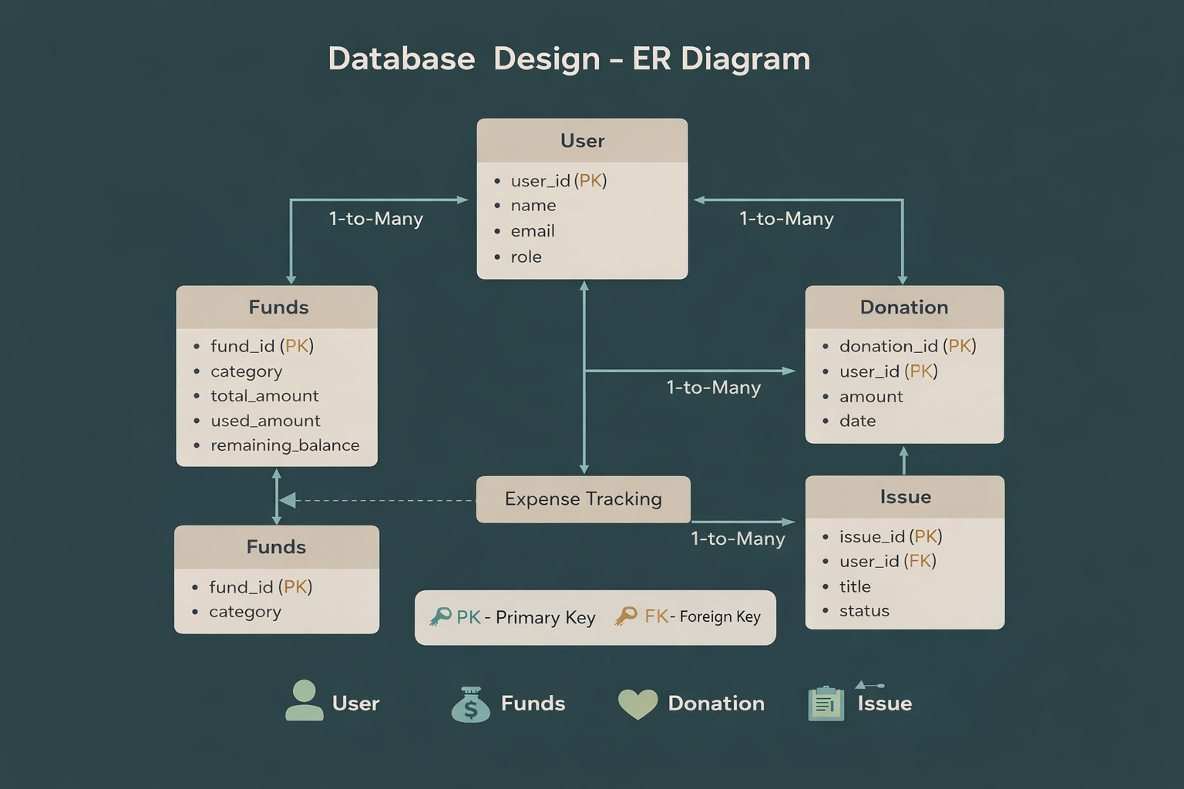
DATABASE DESIGN - ER DIAGRAM

Slide 12
TEST & VALIDATION
✔ Test Cases Prepared
Functional test cases for fund management, donation, and issue reporting modules
API endpoint testing using Postman
Role-based access control testing for villagers and administrators
Database CRUD operations testing
✔ Input Validation
Backend validation for API request data
Required field validation for forms and inputs
Data type validation (numbers, text, dates)
Unique constraints validation (e.g., email, user ID)
✔ Edge Cases Handled
Invalid or expired JWT tokens
Duplicate user registration (email already exists)
Unauthorized access to admin-only features
Missing required fields during issue reporting or donations
Empty or incorrect input data validation
✔ Bugs Fixed
Database foreign key constraint issues
Authentication and role authorization errors
API response handling issues
Frontend–backend API integration mismatches

Slide 13
TEST & VALIDATION
Improvements After Testing
Improved error handling with proper HTTP status codes
Optimized database structure and table relationships
Enhanced input validation for forms and API requests
Better UI feedback for actions like issue reporting and donations
Improved API response consistency between frontend and backend

Slide 14
CHALLENGES FACED
Challenge: Implementing secure authentication and role-based access control for villagers and administrators.
Solution:
Used JWT-based authentication for secure login
Implemented role-based access checks in backend routes
Added protected routes in the frontend
Tested access permissions for each user role
Integration Issues
Challenge: Ensuring smooth communication between React frontend and Node.js/Express backend.
Solution:
Standardized API request and response formats
Configured CORS for secure frontend–backend communication
Used Axios for handling API requests
Tested APIs using Postman before frontend integration

Slide 15
CHALLENGES FACED
Challenge: Designing role-specific dashboards while keeping the interface simple and responsive.
Solution:
Created reusable UI components (Navbar, Sidebar, Forms)
Used conditional rendering based on user roles (villager/admin)
Applied responsive design using CSS/Tailwind
Improved form validation and error messages after testing
Challenge: Optimizing database calls for dashboard data and issue tracking to avoid slow responses.
Solution:
Optimized database queries for fund, donation, and issue data
Reduced unnecessary queries using efficient filtering and aggregation
Loaded related data efficiently for dashboard statistics
Implemented pagination for large datasets to improve performance

Slide 16
FUTURE WORK
Remaining Modules:
Implement admin dashboard improvements for better fund monitoring
Add notification system for complaint status updates
Develop report generation for funds and donations
Optimization:
Further optimize database queries for faster data retrieval
Improve API performance and response time
Enhance dashboard performance for large datasets
Security Enhancements:
Implement rate limiting to prevent API misuse
Improve JWT token security and session handling
Strengthen audit logging and system monitoring
Conduct regular security testing and vulnerability checks

Slide 17
FUTURE WORK
Deployment Status:
Backend configured with Node.js and MySQL database
Frontend application prepared for cloud deployment
Database connection configured for development and testing
Environment variables configured for secure API access
Core system modules running successfully in development
Next Phase Timeline:
Backend API completion and integration – 1 week
System testing and performance improvements – 1 week
Final deployment and documentation – Ongoing

